Slide 1
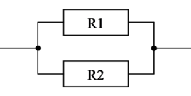

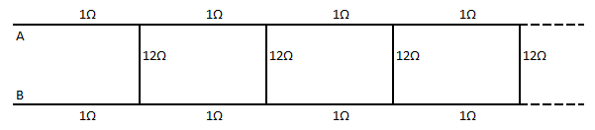
Effective Resistance in Series and Parallel Circuits
Calculate the total or effective resistance between points A & B of infinitely connected wires/resistances, where each vertical line has a resistance of 12 ohms and each horizontal line has a resistance of 1 ohm.

Slide 2
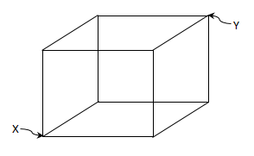

Total resistance between points X & Y
This cube is made of 12 wires/resistances of 5 ohms each. What is the total resistance between points X & Y?

Slide 3


The pressure and volume in a balloon is very low to start with. When you start inflating it both pressure and volume start building up and finally the balloon pops out. How come this is violation of Boyle's law, pressure × volume = constant.
Boyle's law
source: https://www.youtube.com/slowmolaboratory

Slide 4

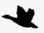

35 mi/hr
45 mi/hr
40 mi/hr
150 miles
Two trains are at a distance of 150 miles from each other and there is a bird on one of the trains. Both the trains started traveling towards each other at speed of 35 miles per hour and 40 miles per hour. At the same time, the bird started traveling at the speed of 45 miles per hour towards the 2nd train. Upon bumping into the 2nd train, the bird bounces and travels back to the 1st train at the same speed. The bird continues a series of bouncing between both the trains until both the trains crash. Now, calculate the total distance traveled by the bird before the trains crash.

Slide 5
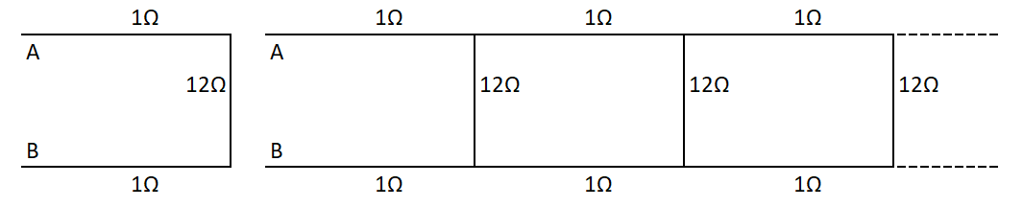
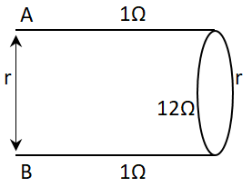

What’s so great about it?
This concept has lots of applications in engineering, math, finance and data science.

Slide 6
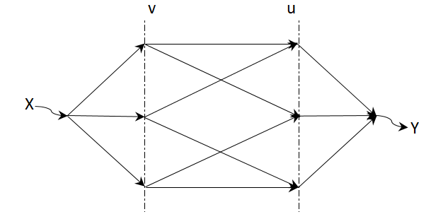

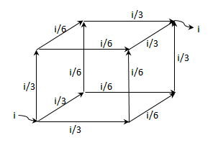
Though the question says each resistance is 5Ω, lets say it’s a resistance of ‘r’

Slide 7

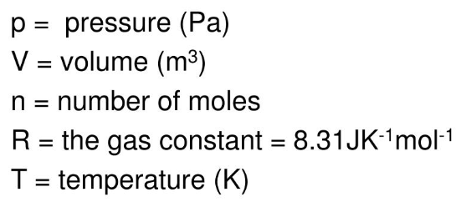

Boyle's law is valid as long as n and T are kept constant

Slide 8

35 mi/hr
45 mi/hr
40 mi/hr
150 miles
Theoretically, the bird will make an infinite number of trips between both the trains before they crash into each other. If we sum all of those infinite trips, then for sure we will go wrong somewhere…
Then is there a smart way to do this? Yes! What is the time taken for the 2 trains to collide? 150/(35+40) = 2 hrs, then what is the distance travelled by the bird in 2 hrs? 45×2= 90 miles.
That is why my teacher always says – don’t work hard but work smart!
Then is there a smart way to do this?

Slide 9


Check out other puzzles in my channel – Aspiring Minds!
Finally, I thank you for watching this video. If you have any questions, please leave them in the comment below.
Also if you want me to make a video in any topic of your interest then please do let me know.
If you like this video then give it a thumbs up and share with your friends, don’t forget to subscribe if you already haven’t. Also please click on the bell button for channel updates.

